Slide 1


Certification Training Session

Slide 2
Exam Objectives
Understand Cloud Concepts
Understand Core Azure Services
Understand Security, Privacy, Compliance, and Trust
Understand Azure Pricing and Support

Slide 3
Cloud Basics
Understand Cloud Services
Understand Key Terms
Understand Cloud Models
Understand Economies of Scale
Understand Cloud Services

Slide 4


Slide 5
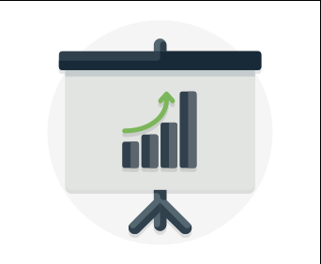
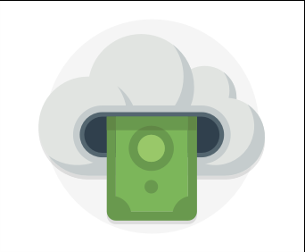


Key Concepts & Terms
Agility
Scalability
Elasticity
Global Reach
Cost
Economies of Scale
Predictive Planning
Availability
Fault Tolerance
Disaster Recovery
Security
Intelligence
Threat Detection
Reporting

Slide 6
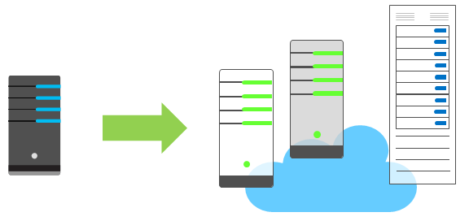
Economies of Scale
Economies of scale are apparent to end users in a number of ways, one of which is the ability to acquire hardware at a lower cost than if a single user or smaller business were purchasing it.
Storage costs, for example, have decreased significantly over the last decade due in part to a cloud providers' ability to purchase larger amounts of storage at significant discounts.

Slide 7
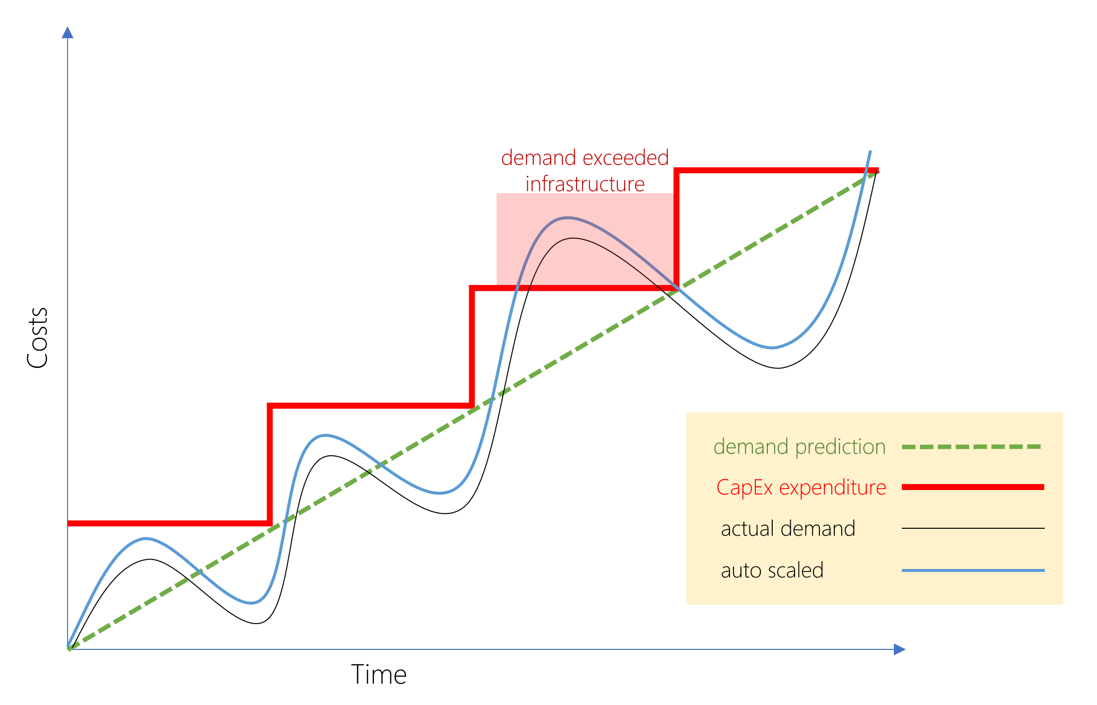
CapEx vs OpEx
Today, organizations can sign up for a service from a cloud provider to get up and running. This enables them to begin selling or providing services to their customers more quickly, without the need for significant upfront costs
If your service is busy and you consume a lot of resources in a month, then you receive a large bill. If those services are minimal and don't use a lot of resources, then you will receive a smaller bill.
A business can still use the CapEx expenditure strategy if they want, but it is no longer a requirement that they do so.
Demand and growth can be unpredictable and can outpace expectation, which is a challenge for the CapEx model as shown in the following graph.

Slide 8

Public Cloud Models
Public Cloud Models have the following characteristics:
Multiple end users - Public cloud providers make resources available to multiple organizations.
Availability – Public clouds are the most common cloud deployment model.
Connectivity - Users and organizations are typically connected to public clouds over the internet.
Skills - Public clouds do not require deep technical knowledge to set up and use
Businesses can use multiple public cloud service providers. Microsoft Azure is an example of a public cloud provider.

Slide 9
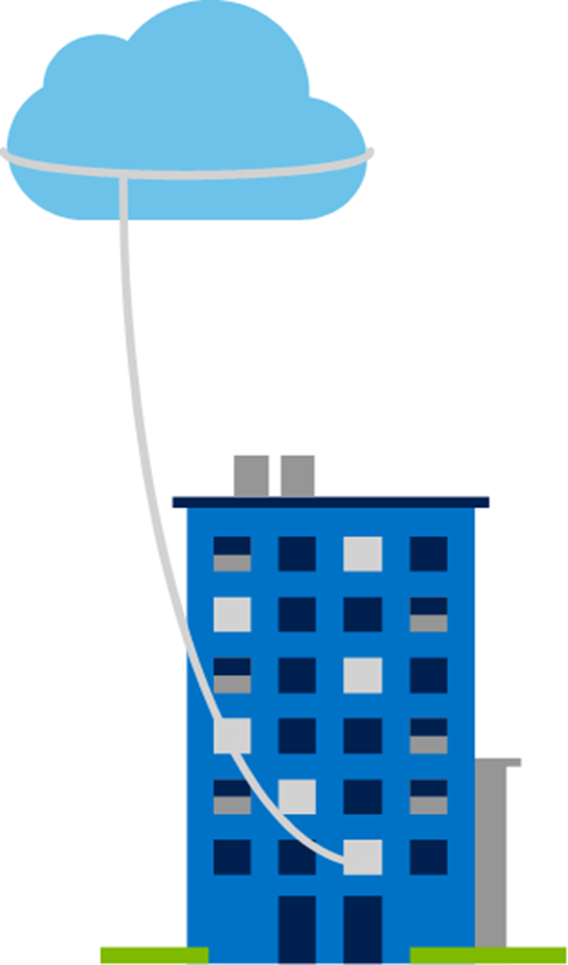
Private Cloud Models
Private Cloud Models have the following characteristics:
Hardware - The organization is entirely responsible for the purchase, maintenance, and management of the hardware.
Users - Private cloud computing resources are used exclusively by a single organization.
Connectivity - A connection is typically made over a private network that is highly secure.
Public access - A private cloud does not provide access to the public.
Skills - Deep technical knowledge is required to set up, manage, and maintain the private cloud.

Slide 10
Hybrid Cloud Models
Hybrid Cloud Models have the following characteristics:
Resource location - Specific resources are used in a public cloud, others are used in a private cloud.
Cost and efficiency - Hybrid cloud models allow an organization to leverage some of the benefits of cost, efficiency, and scale that are available with a public cloud model.
Control - Organizations retain management control in private clouds.
Skills - Technical skills are required to maintain the private cloud and ensure both cloud models can operate together.
Hybrid cloud scenarios can be useful when organizations have some information that cannot be put in a public cloud, possibly for legal reasons. For example, you may have medical data that cannot be exposed publicly.

Slide 11
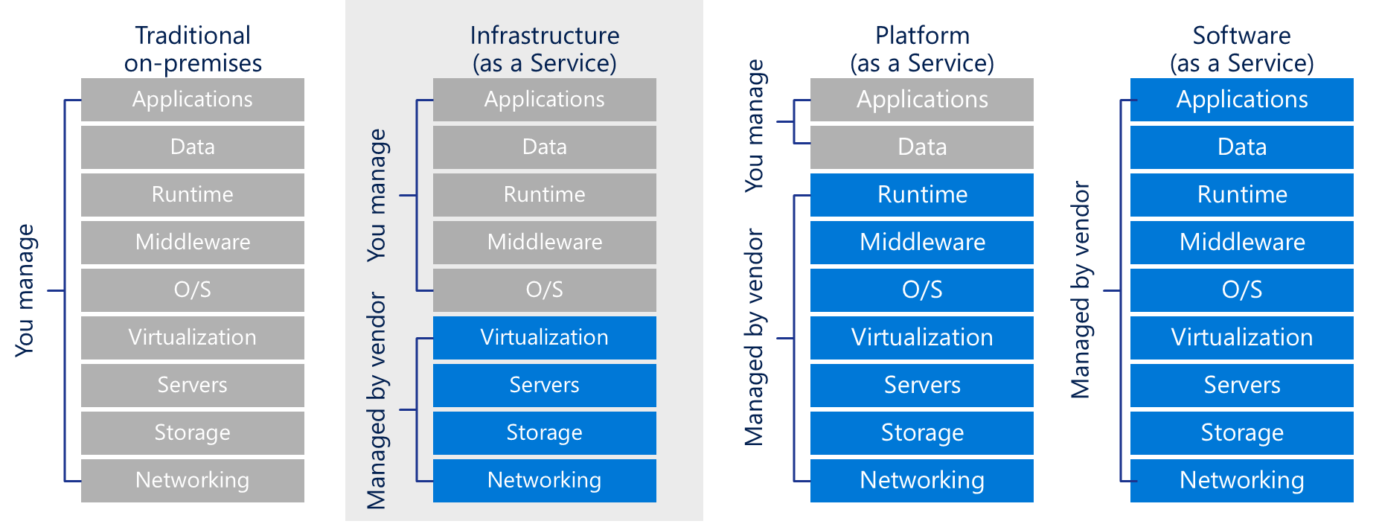

Cloud Service Comparison
There is a shared responsibility model for ensuring cloud workloads are run securely and in a well-managed way. Depending on the service you are using, the cloud provider is responsible for some aspects of the workload, leaving the customer responsible for the remaining aspects of the workload.

Slide 12
Azure Core Services
Understand core Azure architectural components
Understand core Azure services and products
Understand Azure solutions
Understand Azure management tools

Slide 13
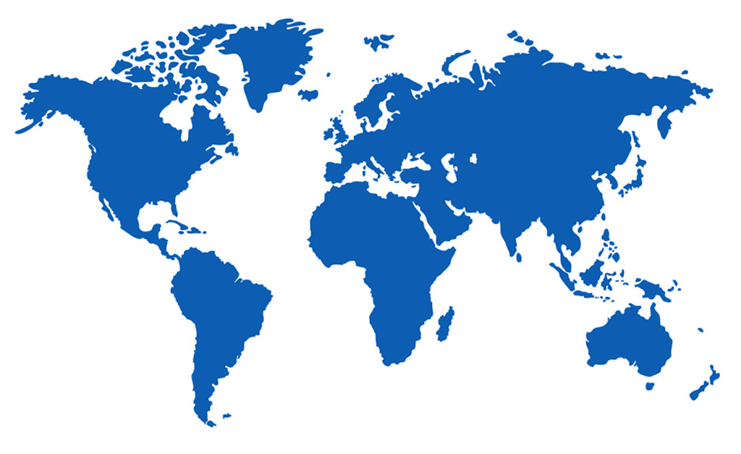
Regions
Azure is made up of datacenters located around the globe. These datacenters are organized and made available to end users by country/region
In reference to datacenters, a region is a geographical area on the planet containing at least one, but potentially multiple datacenters that are in close proximity and networked together with a low-latency network
Each region is paired with another within the same geography (such as US, Europe, or Asia). This approach allows for the replication of resources and helps reduce the likelihood of interruptions due to events such as natural disasters, power outages, or physical network outages.

Slide 14
Geographies
A geography is a discrete market typically containing two or more regions that preserves data residency and compliance boundaries
Geographies allow customers with specific data-residency and compliance needs to keep their data and applications close
Geographies are broken up into Americas, Europe, Asia Pacific, Middle East, and Africa

Slide 15
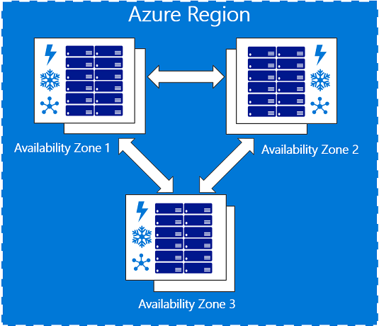
Availability Zones
Availability zones are physically separate locations within an Azure region.
Each availability zone is made up of one or more datacenters equipped with independent power, cooling, and networking.
Availability Zones are set up to be an isolation boundary.
If one availability zone goes down, the other continues working.

Slide 16
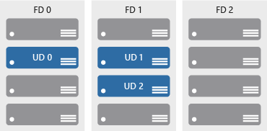
Availability Sets
Availability sets comprise of update and fault domains:
Update domains. When a maintenance event occurs (such as a performance update or critical security patch applied), the update is sequenced through update domains.
Fault domains. Fault domains provide for the physical separation of a workload across different hardware in the datacenter.
Availability sets help ensure applications remain online during maintenance events, or hardware failure.

Slide 17
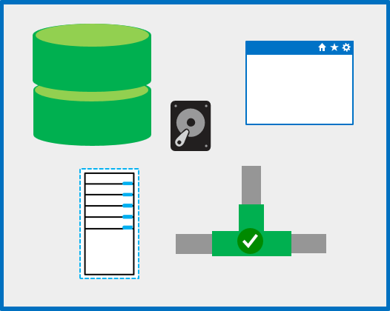
Resource Groups
A resource group is a unit of management, similar to a container that allows you to aggregate and manage all resources required for an application to run within a single manageable unit
Resource groups allow you to control costs, set automation and set policy against resources

Slide 18
Resource Manager
Azure Resource Manager is a management layer in which resource groups and all the resources within it are created, configured, managed, and deleted.
With Azure Resource Manager, you can:
Deploy application resources
Organize resources
Control access and resources
Azure Resource Manager, provides a consistent management layer that allows you to automate deployment and configuration of resources using different automation and scripting tools, such as Azure PowerShell, Azure Command-Line Interface, Azure portal, REST API, and client software development kits (SDKs).

Slide 19
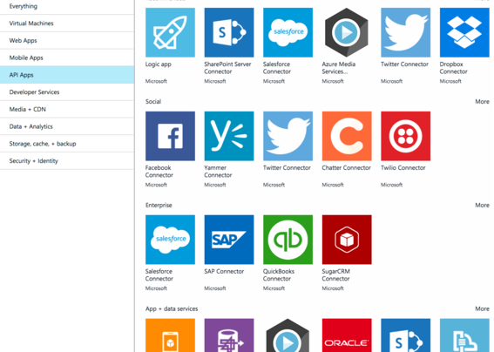
Azure Marketplace
Azure Marketplace is a service on Azure that helps connect end users with Microsoft partners, independent software vendors (ISVs), and start-ups that are offering their solutions and services, which are optimized to run on Azure
Azure Marketplace allows customers mostly IT professionals and cloud developers to find, try, purchase, and provision applications and services from hundreds of leading service providers, all certified to run on Azure.

Slide 20

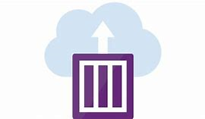


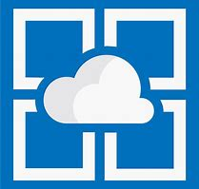

Azure Compute
Examples of Azure services for virtual machines include:
Azure VMs. Infrastructure as a service (IaaS) used to create VMs in the cloud
VM scale sets. Designed for automatic scaling of identical VMs
App services. platform as a service (PaaS) offerings to build, deploy, and scale enterprise-grade web, mobile, and API apps
Functions. Creates infrastructure based on an event
Examples of Azure services for containers include:
Azure Container Instances. A PaaS offering that allows you to upload your containers, which it then will run for you
Azure Kubernetes Service. A container orchestrator service for managing large numbers of containers

Slide 21





Azure Networking
Networking on Azure allows you to connect cloud and on-premises infrastructure and services.
Azure Virtual Network enables resources such as Azure VMs to securely communicate with each other, the internet, and on-premises networks.
Azure Load Balancer provides scale for your applications and high availability for your services
A VPN gateway sends encrypted traffic between an Azure Virtual Network and an on-premises location over the public internet.
Azure Application Gateway is a web traffic load balancer and the connection through which users connect to your application.
A content delivery network (CDN) is a distributed network of servers that get content to users in their local region to minimize latency.

Slide 22



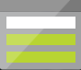
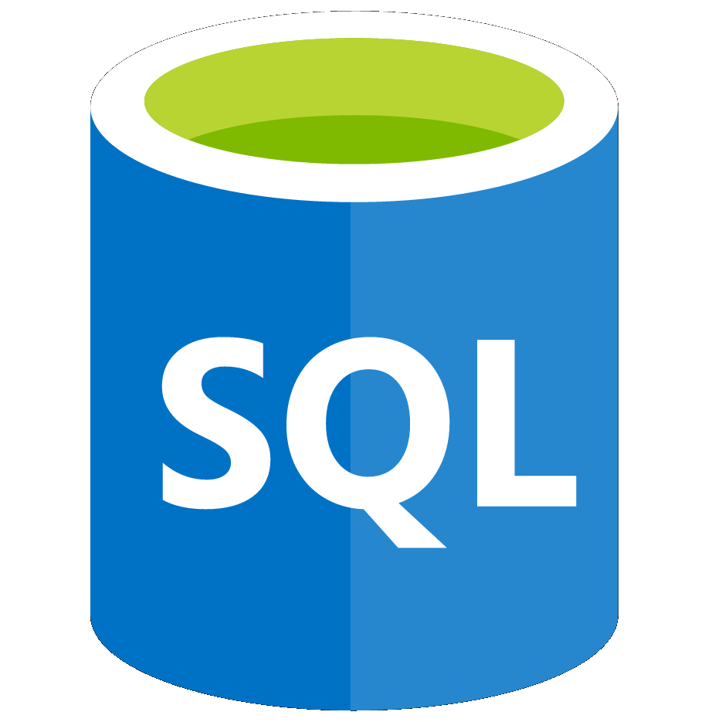

Azure Data Services
Azure Storage is a service that you can use to store files, messages, tables, and other types of information.
Blob storage. No restrictions on the kinds of data it can hold. Blobs are highly scalable
Disk storage. Provides disks for virtual machines, applications, and other services
File storage. Azure Files offers fully-managed file shares in the cloud
Archive storage. Storage facility for data that is rarely accessed
Azure database services are fully-managed PaaS database services that free up valuable time you’d otherwise spend managing your database
Azure Cosmos DB. A globally-distributed database service that enables you to elastically and independently scale throughput and storage
Azure SQL Database. A relational database as a service (DaaS) based on the latest stable version of the Microsoft SQL Server database engine

Slide 23
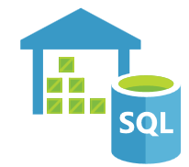



Big Data & Analytics
Big data refers to large volumes of data that become increasingly hard to make sense of, or consequently make decisions about. Some big data and analytic services in Azure include:
Azure SQL Data Warehouse leverages massively parallel processing (MPP) to run complex queries quickly across petabytes of data.
Azure HDInsight makes it easier, faster, and more cost-effective to process massive amounts of data and runs popular open-source frameworks such as Spark, Hadoop and Storm.
Azure Data Lake Analytics simplifies big data. Instead of deploying, configuring, and tuning hardware, you write queries to transform your data and extract valuable insights.
Azure Databricks is a Spark based analytics platform optimized for Azure and provides one-click setup, streamlined workflows, and an interactive workspaces that enable collaboration between data scientists, data engineers, and business analysts.

Slide 24


Internet of Things
The ability for devices to gather and then relay information for data analysis is referred to as the Internet of Things (IoT)
Microsoft IoT Central is a fully managed global Internet of Things (IoT) solution that makes it easy to connect, monitor, and manage your IoT assets at scale.
Azure IoT Hub is a managed service that acts as a central message hub for bi-directional communication between your IoT application and the devices it manages.

Slide 25


Artificial Intelligence
Artificial Intelligence (AI), in the context of cloud computing, is based around a broad range of services, the core of which is machine learning. Machine learning is a data science technique that allows computers to use existing data to forecast future behaviours, outcomes, and trends.
Using machine learning, computers learn without being explicitly programmed.
Some AI services in Azure include:
Azure Machine Learning service. Provides a cloud-based environment used to develop, train, test, deploy, manage, and track machine learning models
Azure Machine Learning Studio. A collaborative, drag-and-drop visual workspace where you can build, test, and deploy machine learning solutions without needing to write code

Slide 26





Cognitive Services
Cognitive services are a collection of domain-specific pre-trained AI models that can be customized with your data. They are categorized broadly into vision, speech, language, and search.
Vision makes it possible for apps and services to accurately identify and analyse content within images and videos.
Speech services can convert spoken language into text, or produce natural-sounding speech from text using standard (or customizable) voice fonts.
Language services can understand the meaning of unstructured text or recognize the speaker’s intent.
Harness the power of a web-scale, ad-free search engine. Find information across billions of web pages, images, videos, and news search results.
Knowledge services create rich knowledge resources that integrate into apps and services.

Slide 27
Serverless Computing
Serverless computing is a cloud-hosted execution environment that runs your code but abstracts the underlying hosting environment.
Some serverless services in Azure include:
Azure Functions are ideal when you're only concerned with the code running your service and not the underlying platform or infrastructure and commonly used when you need to perform work in response to an event.
Azure Logic Apps help you automate and orchestrate tasks, business processes, and workflows when you need to integrate apps, data, systems, and services across enterprises or organizations.
Azure Event Grid allows you to easily build applications with event-based architectures. It's a fully-managed, intelligent event routing service that uses a publish-subscribe model for uniform event consumption.

Slide 28
Security, Privacy, Compliance, and Trust
Understand how to secure network connectivity.
Understand core Azure identity services.
Understand security tools and features.
Understand Azure governance methodologies.
Understand monitoring and reporting in Azure.
Understand privacy, compliance, and data protection standards in Azure.

Slide 29
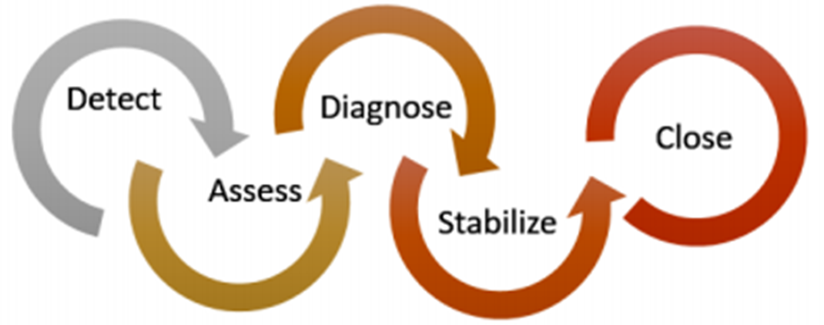
Azure Security Center
Azure Security Center is a monitoring service that provides threat protection across all of your services both in Azure, and on-premises.
Azure Security Center is available in two tiers:
Free - Available as part of your Azure subscription but limited to assessments and recommendations of Azure resources only.
Standard - Provides a full suite of security-related services including continuous monitoring, threat detection and just-in-time access control.

Slide 30
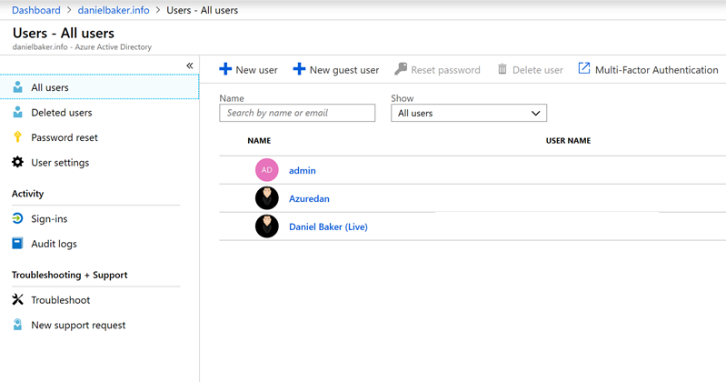
Azure Active Directory
Azure Active Directory is a cloud-based identity and access management service that helps employees of an organization sign in and access resources, providing services such as:
Authentication
Single sign-on (SSO)
Multi-Factor Authentication
Application management
Business to business (B2B) identity services
Business-to-Customer (B2C) identity services

Slide 31
Advanced Protection Services
Microsoft Azure Information Protection helps organizations classify and protect intellectual property by applying labels, this can be:
Automatically by administrators who define rules and conditions
Manually by users
A combination of the two, where users are given recommendations
Azure Advanced Threat Protection identifies, detects, and helps you investigate threats, compromised identities, and malicious insider actions. It consists of the following components:
Azure ATP portal - Monitor and respond to suspicious activity
Azure ATP sensor: which are installed directly on your domain controllers.
Azure Key Vault is a centralized service that you use for storing application secrets. It helps control application secrets by keeping them in a single, central location and providing secure access, permissions control, and access logging.

Slide 32
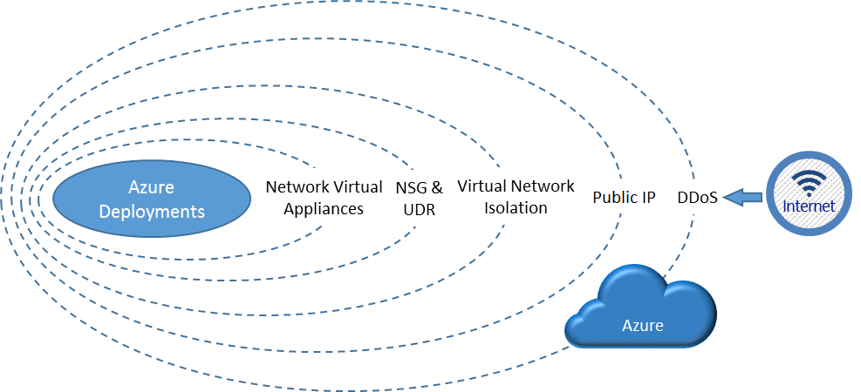
Network Protection
Network Security Groups filter network traffic to and from Azure resources in an Azure virtual network. They can contain multiple inbound and outbound security rules that filter traffic to and from resources by source and destination IP address, port, and protocol.
Azure Firewall is a fully stateful firewall as a service with built-in high availability and unrestricted cloud scalability. Features include inbound and outbound filtering rules and advanced Monitor logging
Azure DDoS Protection protects your Azure applications by scrubbing traffic at the Azure network edge before it can impact your service's availability.

Slide 33
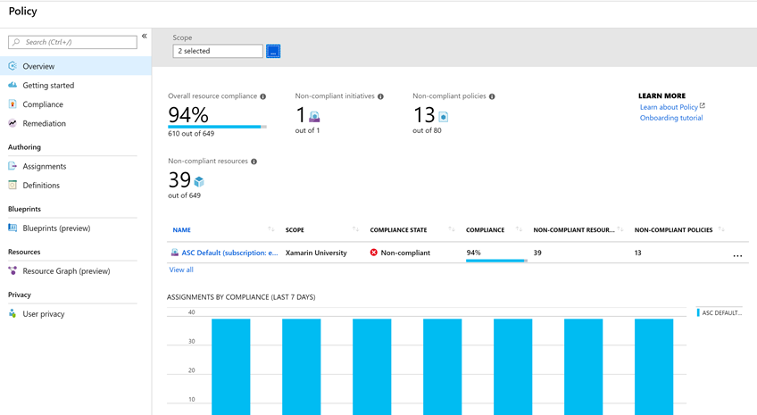
Azure Policies and Initiatives
Azure Policies enforce rules and effects over your resources keeping them compliant with corporate standards and SLAs.
Azure Policy uses policies and initiatives to run evaluations of your resources, scanning for those not compliant.
Initiatives work alongside policies, simplifying the process of managing policy definitions by grouping as a single item.
Azure Policy comes with a number of built-in policy and initiative definitions under categories such as Storage, Networking , Compute, and Monitoring.

Slide 34
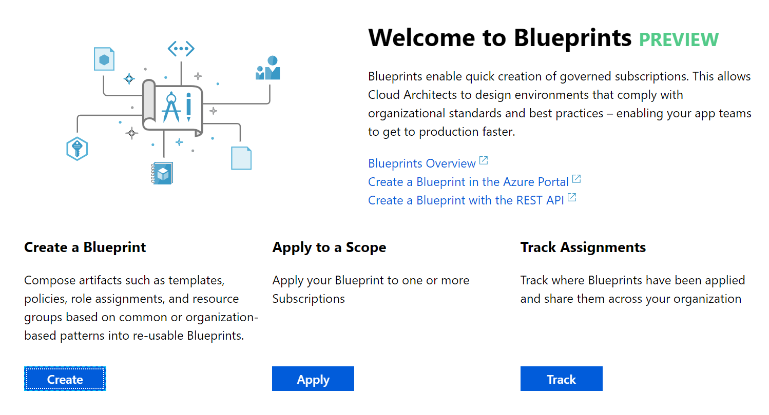
Azure Blueprints
Azure Blueprints enable cloud architects to define a repeatable set of Azure resources that implement and adhere to an organization's standards, patterns, and requirements.
Usage Scenarios:
Use Blueprint artifacts and tools to help with auditing, traceability, and compliance of deployments.
Use with DevOps scenarios, where blueprints are associated with specific build artifacts and release pipelines, and require more rigorous tracking.

Slide 35
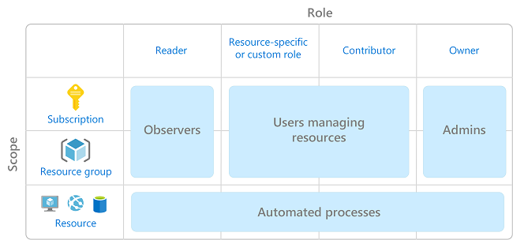
Role Based Access Control
Role-based access control (RBAC) provides fine-grained access management for Azure resources.
Grants users the rights they need to perform their jobs and is provided at no additional cost to all Azure subscribers
Examples of when you might use RBAC include when you want to:
Allow one user to manage VMs in a subscription, and another user to manage virtual networks.
Allow a database administrator (DBA) group to manage Microsoft SQL Server databases in a subscription.
Allow a user to manage all resources in a resource group, such as VMs, websites, and subnets.

Slide 36
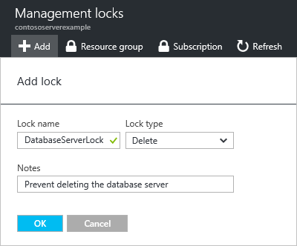
Locks
Locks help you prevent accidental deletion or modification of your Azure resources. You manage these locks from within the Azure portal.
You may need to lock a subscription, resource group, or resource to prevent other users in your organization from accidentally deleting or modifying critical resources. You can set the lock level to:
Delete. Authorized users can still read and modify a resource, but they can't delete the resource.
ReadOnly. Authorized users can read a resource, but they can't delete or update the resource. Applying this lock is similar to restricting all authorized users to the permissions granted by the Reader role.

Slide 37
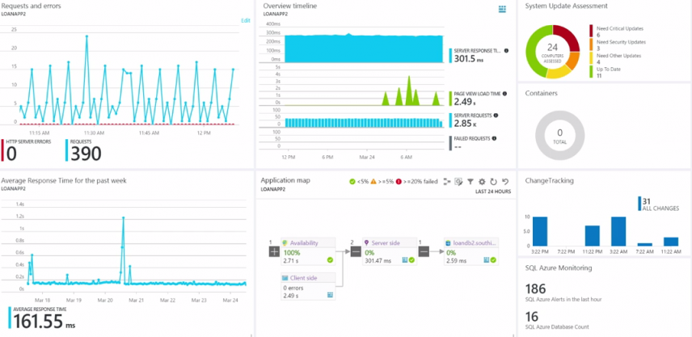
Azure Monitor
Azure Monitor maximizes the availability and performance of applications by delivering a comprehensive solution for collecting, analyzing, and acting on telemetry from cloud and on-premises environments.
As soon as you create an Azure subscription and start adding resources, Azure Monitor starts collecting data.
Azure Monitor integrates with other Azure services to provide robust monitoring capabilities. These can be categorised as:
Analyze. Use Azure Monitor for containers and virtual machines, and Application Insights for applications.
Respond. Proactively respond to critical conditions identified using Azure Alerts, or Auto-scale using Azure Monitor metrics.
Visualize items such as charts, tables, or Power BI.
Integrate: Integrate Azure Monitor with other systems and build custom solutions.

Slide 38
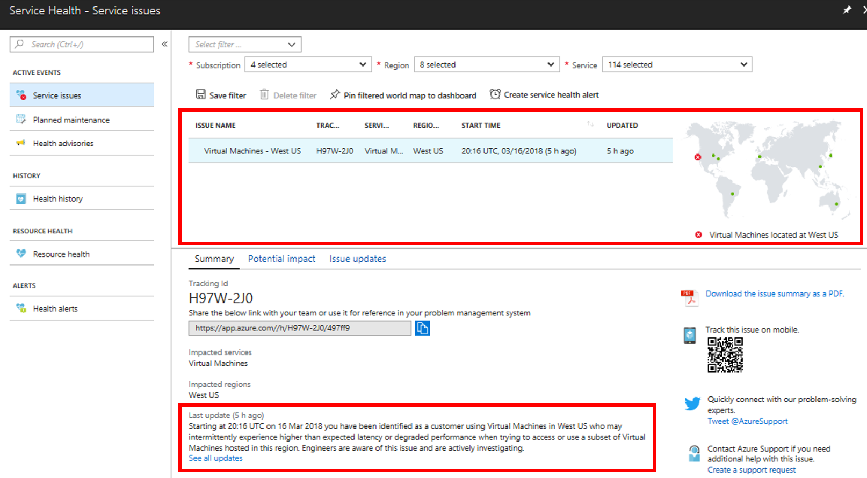
Azure Service Health
Azure Service Health is a suite of experiences that provide personalized guidance and support when issues with Azure services arise. It can notify you, help you understand the impact of issues, and keep you updated as the issue is resolved.
Azure Service Health is composed of:
Azure Status. Provides a global view of the health state of Azure services.
Service Health. A customizable dashboard that tracks the state of Azure services in the regions where you use them.
Azure Resource Health: Diagnose and obtain support when an Azure service issue affects your resources.

Slide 39
Compliance and Privacy
Microsoft provides the most comprehensive set of compliance offerings (including certifications and attestations) of any cloud service provider.
You can view all the Microsoft compliance offerings at Microsoft Compliance Center - Compliance Offerings.
Microsoft Privacy Statement explains what personal data Microsoft processes, how Microsoft processes it, and for what purposes.
This applies to the interactions Microsoft has with users and Microsoft products such as Microsoft services, websites, apps, software, servers, and devices.
It is intended to provide openness and honesty about how Microsoft deals with personal data in its products and services.
For more information, review the privacy statement at Microsoft Privacy Statement.

Slide 40
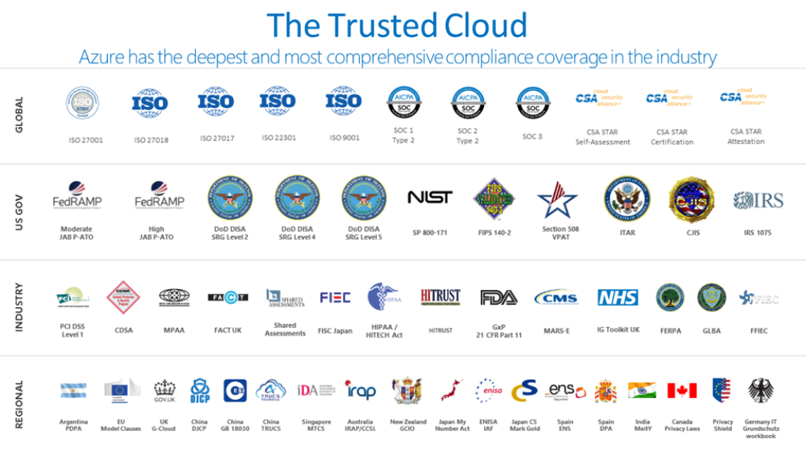
Microsoft runs on Trust
Trust Center is a website resource containing information and details about how Microsoft implements and supports security, privacy, compliance, and transparency in all our cloud products and services.
The Service Trust Portal is the Microsoft public site for publishing audit reports and other compliance-related information related to Microsoft’s cloud services.
It also hosts the Compliance Manager service, and allows you to:
Access audit reports across Microsoft cloud services.
Access compliance guides to help understand how to manage compliance with various regulations.
Access trust documents to help understand how Microsoft cloud services help protect your data.

Slide 41
Azure Pricing and Support
Subscriptions and Management groups
Plan and manage Azure costs
Identify Azure support options
Understand Azure Service Level Agreements
Understand the service lifecycle in Azure

Slide 42
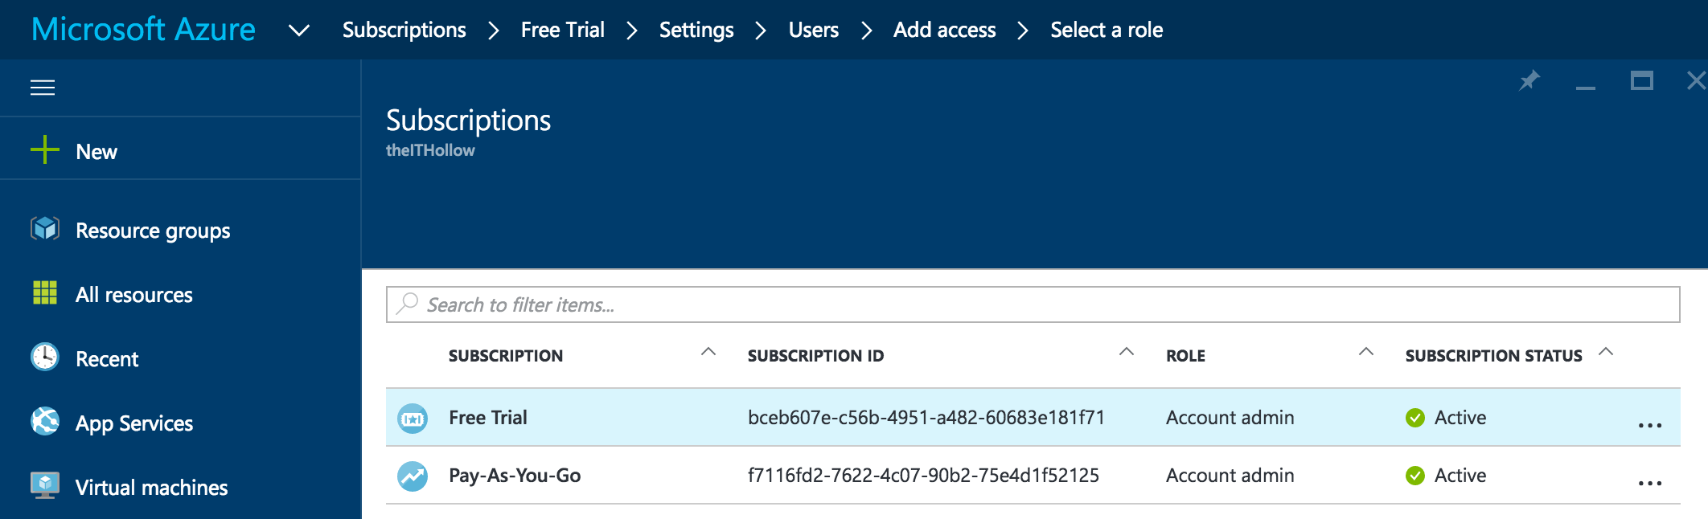
Azure Subscriptions
An Azure subscription provides you with authenticated and authorized access to Azure products and services. It is a logical unit that links to an Azure account.
Azure offers free and paid subscription options to suit different needs and requirements. An account can have one subscription or multiple subscriptions that have different billing models, and to which you apply different access-management policies.
You can use Azure subscriptions to define boundaries around Azure products, services, and resources. This includes:
Billing boundary which determines how an Azure account is billed for using Azure.
Access control boundary which applies access management policies at the subscription level.

Slide 43
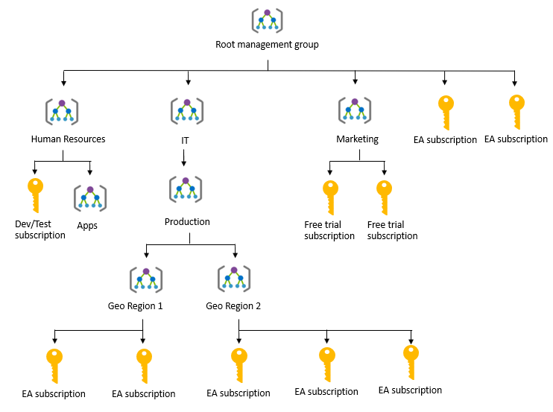
Management Groups
Azure Management groups are containers for managing access, policies, and compliance across multiple Azure subscriptions.
Management groups allow you to order your Azure resources hierarchically into collections, which provide a further level of classification beyond subscriptions.

Slide 44
Zones
A zone is a geographical grouping of Azure Regions for billing purposes:
Zone 1. Includes West US, East US, West Europe, and others.
Zone 2 . Includes Australia Central, Japan West, Central India, and others.
Zone 3. Includes Brazil South only.
DE Zone 1. Includes Germany Central and Germany Northeast.

Slide 45
Purchasing Options
Enterprise customers commit to spending a negotiated amount on Azure services, which they typically pay annually.
Web direct customers sign up through the Azure website.
Cloud solution providers are Microsoft partner companies that a customer hires to build solutions on top of Azure. Payment and billing for Azure usage occurs through the customer's CSP.
Three factors affect costs:
Resource Type: Costs are resource-specific, so the usage that a meter tracks and the number of meters associated with a resource depend on the resource type.
Services: Azure usage rates and billing periods can differ between Enterprise, Web Direct, and CSP customers.
Location: The Azure infrastructure is globally distributed, and usage costs might vary between locations that offer particular Azure products, services, and resources.

Slide 46
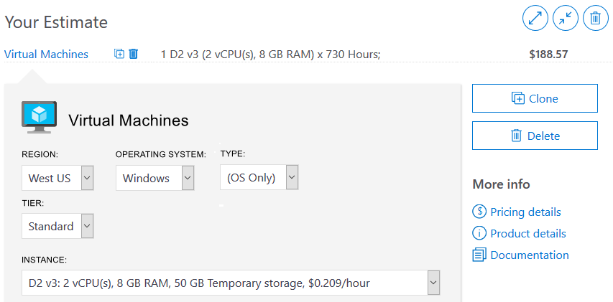
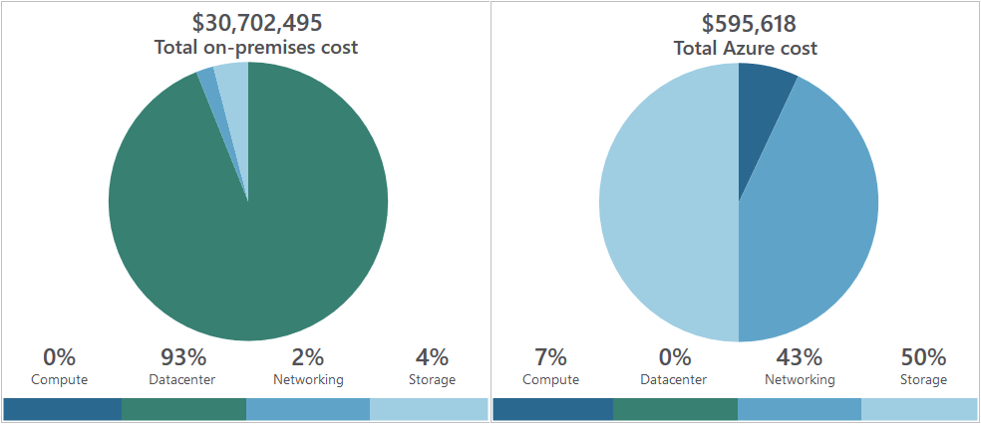
Purchasing Calculators
Azure Calculator
Helps you estimate the your needs and configure them according to your specific requirements
Azure provides a detailed estimate of the costs associated with your selections and configurations
TCO Calculator
Helps you estimate cost savings realized by migrating to Azure
Compares the costs of on-premises infrastructures with the costs of using Azure products and services to host infrastructure in the cloud

Slide 47
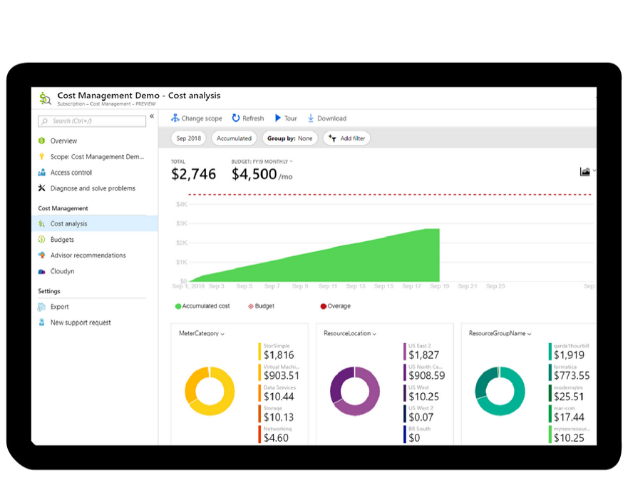
Azure Cost Management
Azure Cost Management provides a set of tools for monitoring, allocating, and optimizing Azure costs
Azure Cost Management Includes:
Reporting
Improved accountability with resource tags
Monitor resource demand trends, consumption rates, and cost patterns
Alerting based on cost and usage budgets
Recommendations to eliminate idle resources and to optimize provisioned Azure resources

Slide 48
Azure Support
Every Azure subscription includes:
Free access to billing and subscription support
Azure products and services documentation
Online self-help documentation
Community support forums
Paid Azure support plans:
Developer for trial and nonproduction environments
Standard for production environments
Professional Direct for organizations with business-critical dependence on Azure
Premier for organizations with substantial dependence on Microsoft products, including Azure.
Other support channels include:
Azure community support.
stack overflow
Azure Feedback Forums
Twitter: @AzureSupport

Slide 49
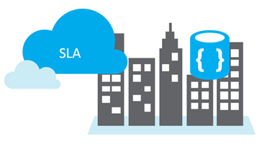
Service Level Agreements
SLAs define Microsoft’s commitment to an Azure service or product
Individual SLAs are available for each Azure product and service
SLAs also define what happens if a service or product fails to meet the designated availability commitments
Three key characteristics of SLAs for Azure products and services:
Performance targets, uptime and connectivity guarantees
Performance targets range: Typical SLAs specify performance-target commitments ranging from 99.9 percent to 99.99 percent.
Service credits: Percentage of the applicable monthly service fees credited to you if a service fails to meet uptime guarantee

Slide 50
Preview Features
Microsoft offer previews of Azure features for evaluation purposes, these include:
Private Preview. An Azure feature is available to certain Azure customers for evaluation purposes
Public Preview. An Azure feature is available to all Azure customers for evaluation purposes
Review a list of preview features that are available for evaluation at Azure Preview Features
To preview a feature, select the Try it button for the applicable feature
Portal Preview features:
Access preview features that are specific to the Azure Portal from the Portal Preview Features page.
Typical portal preview features provide performance, navigation, and accessibility improvements to the Azure portal interface

Slide 51
General Availability
Once a feature is evaluated and tested successfully, it will typically be released to customers as part of Azure's default product, service, or feature set.
Information about the latest updates to Azure products, services, and features, and product roadmaps, and announcements are available at Azure updates
Azure updates page:
View details about all Azure updates
See which updates are in general availability, preview, or development
Subscribe to Azure update notifications by RSS

Slide 52
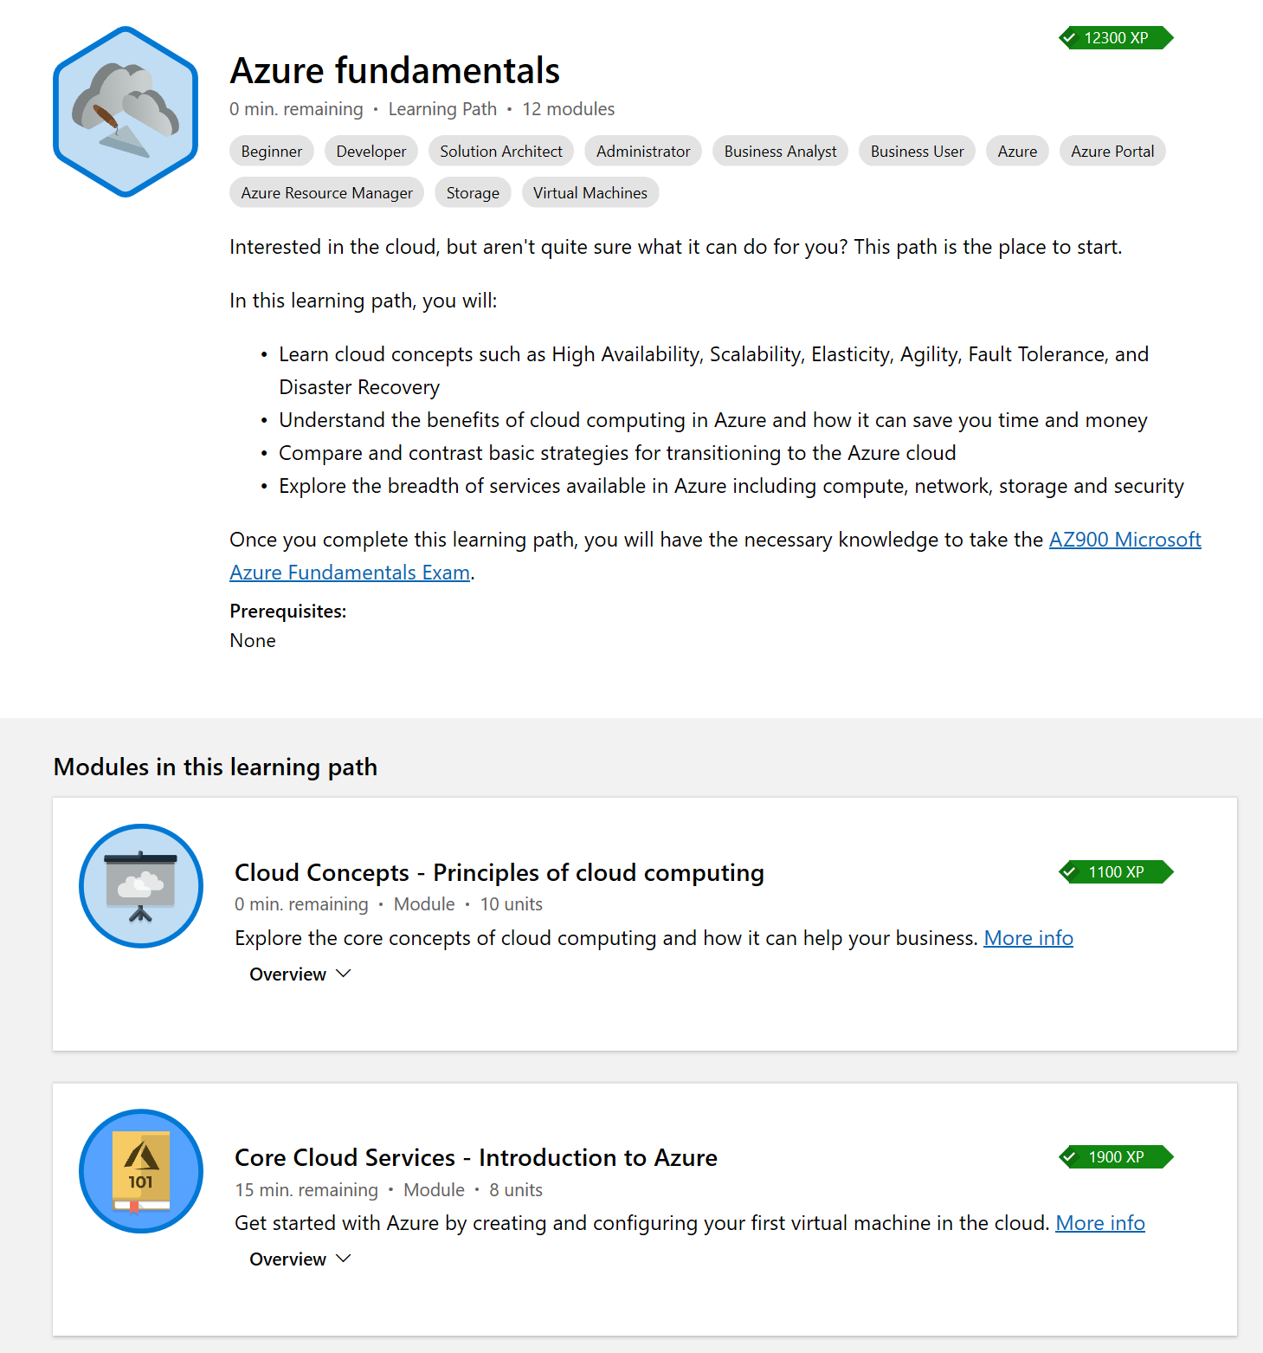
Next Steps
Azure Fundamentals
Learn cloud concepts such as High Availability, Scalability, Elasticity, Agility, Fault Tolerance, and Disaster Recovery
Understand the benefits of cloud computing in Azure and how it can save you time and money
Compare and contrast basic strategies for transitioning to the Azure cloud
Explore the breadth of services available in Azure including compute, network, storage and security

